Slide 1
PHATE

Slide 2
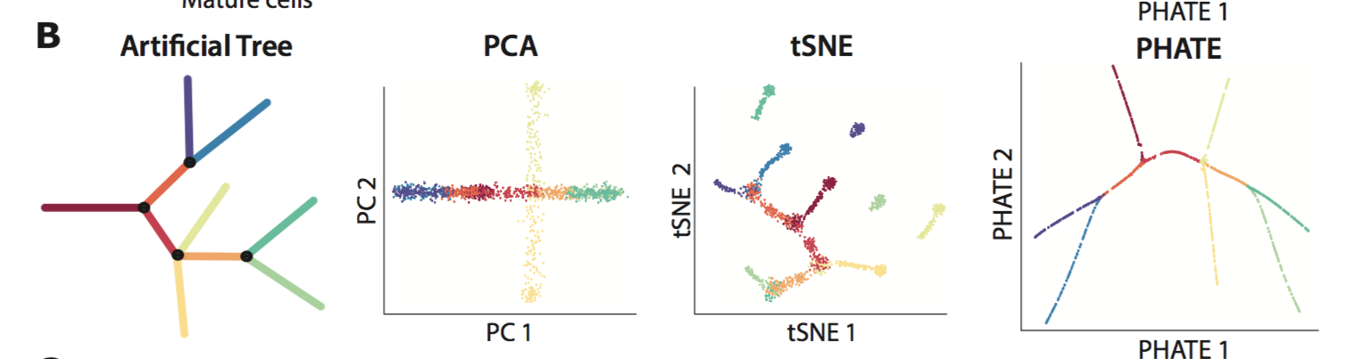
Visualization methods fail to capture global structure in high dimensional data

Slide 3
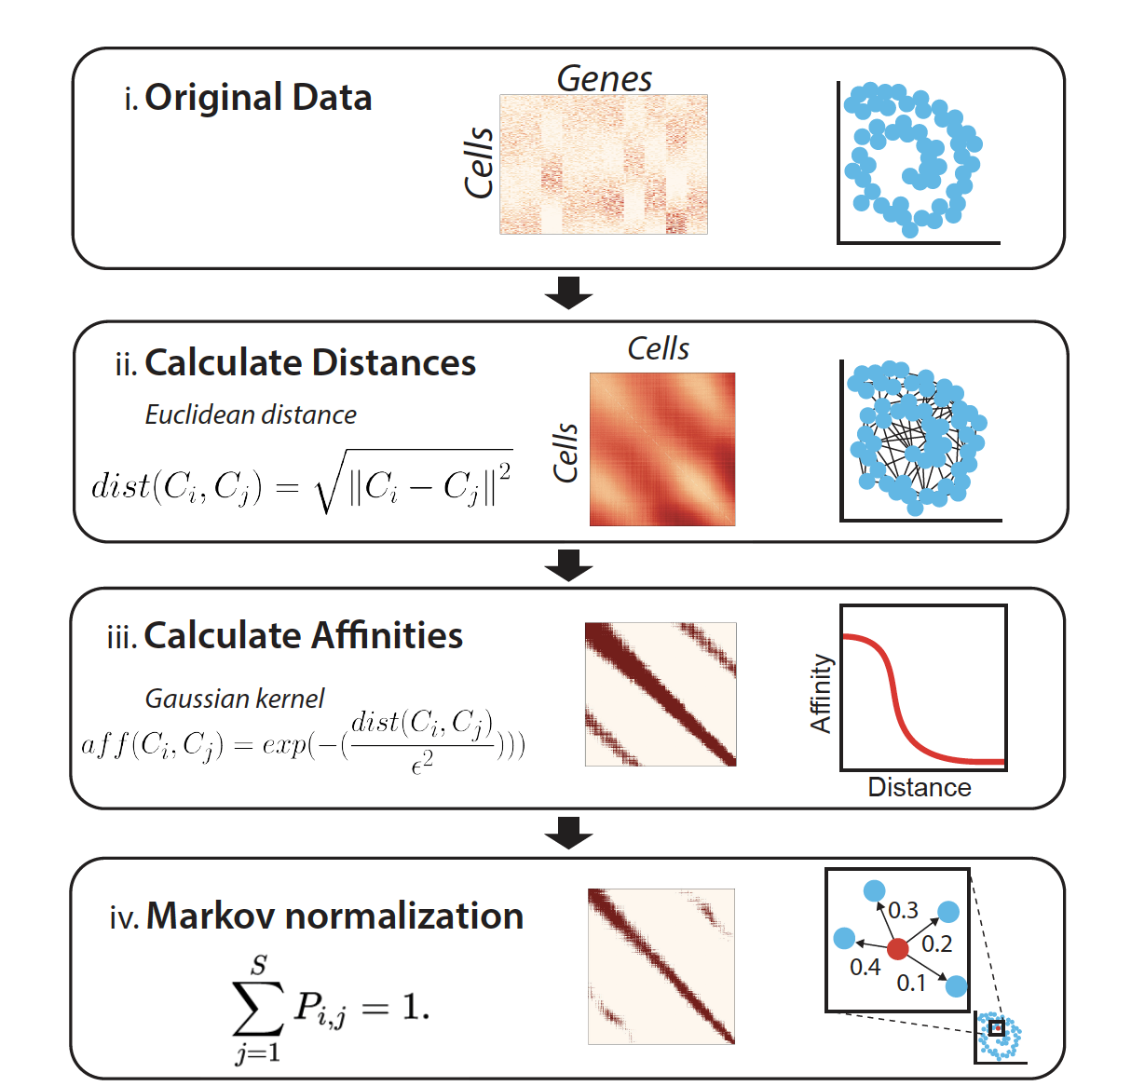
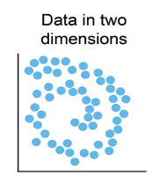
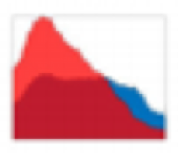
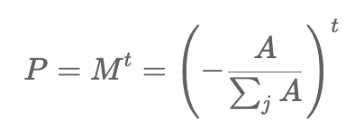
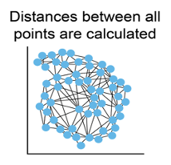

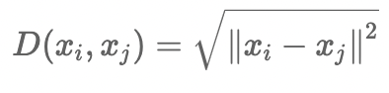
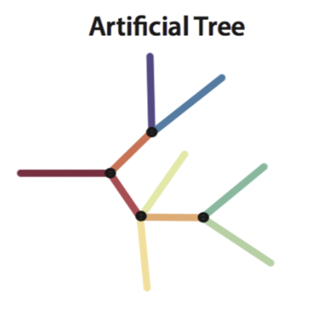
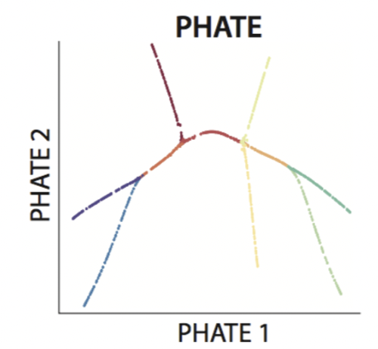
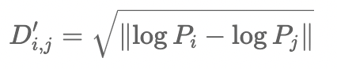
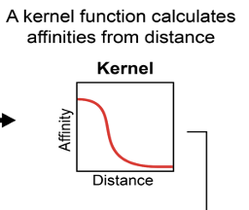

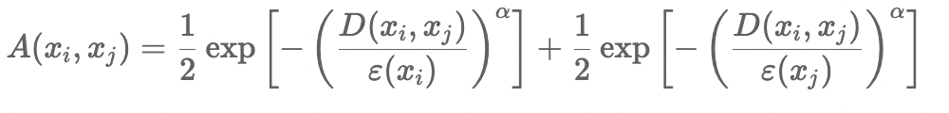
PHATE Algorithm
IV Calculate diffusion probability matrix
probability distribution
Transpose
C₁ = [ p₁₁ p₁₂ …….p_{1n}]
C_{i} = [ p_{i1} p_{i2} …….p_{in}]
C_{j} = [ p_{j1} p_{j2} …….p_{jn}]
C_{n} = [ p_{n1} p_{n2} …….p_{nn}]
P
1 2 3 … n
Distance matrix
V MDS on informational distance matrix
affinity matrix

Slide 4
(Moon K, van Dijk D., Nature Biotechnology 2019)

Slide 5
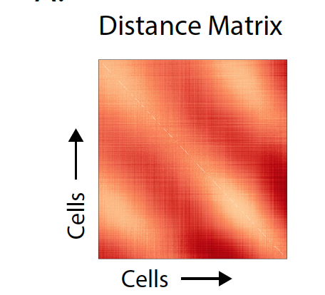
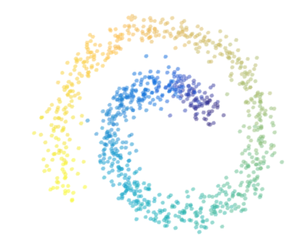
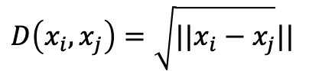
Distance Matrix
Entries are distances
$$D\left(x_{i},x_{j}\right)=\sqrt{||x_{i}−x_{j}}||$$

Slide 6
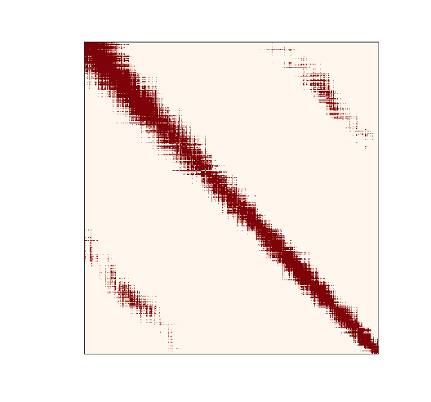
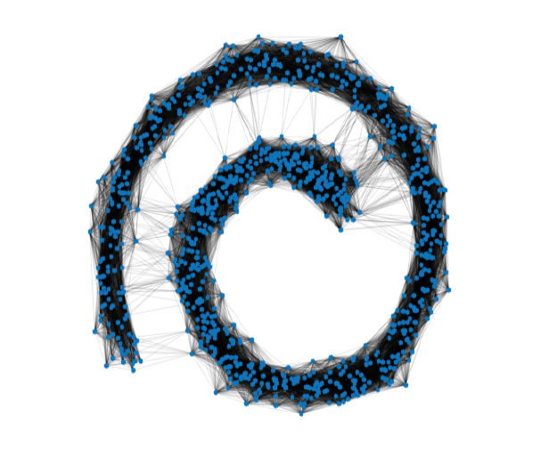
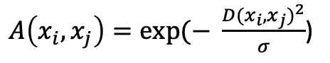
Affinity Matrix
(Gaussian Kernel)
Graph Representation
Entries are affinities
$A\left(x_{i},x_{j}\right)=exp⁡(− \frac{{D(x_{i},x_{j})}^{2}}{σ}$)

Slide 7
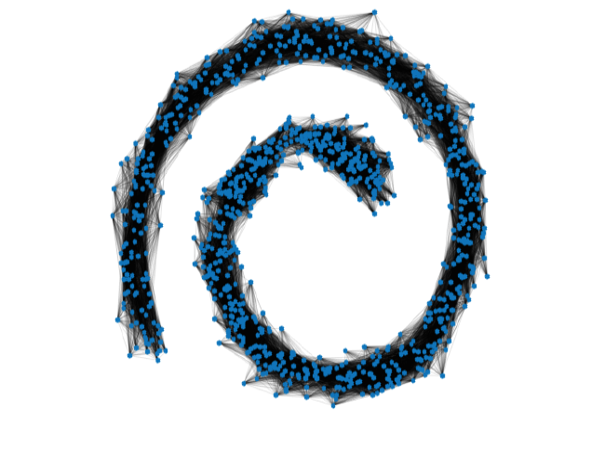
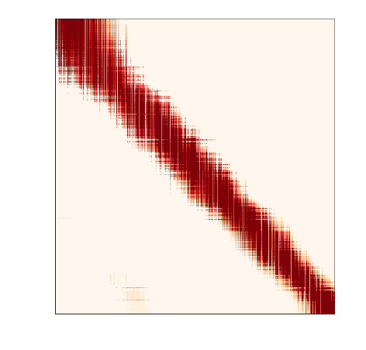
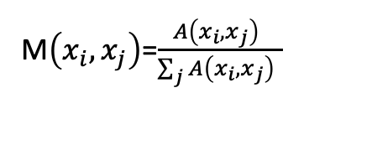
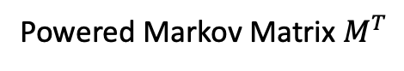
Powered Markov Matrix
Powered Markov Matrix $M^{T}$
Entries are row normalized affinities
M$\left(x_{i},x_{j}\right)$=$\frac{A\left(x_{i},x_{j}\right) }{\sum_{j}{A\left(x_{i},x_{j}\right) }}$

Slide 8
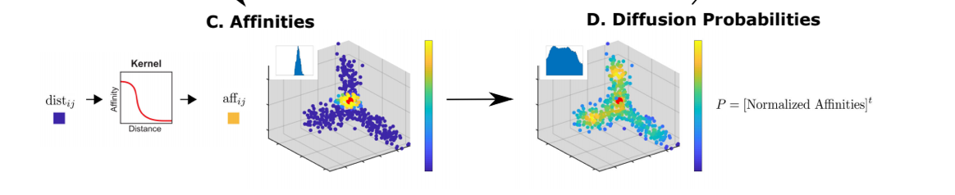
PHATE: Keeps global structure
Step 0. Denoise the connectivity by diffusion
Step 1. Each cell is represented as a t-step diffusion probability to ALL other cells
C₁ = [ p₁₁ p₁₂ …….p_{1n}]
C₂ = [ p₂₁ p₂₂ …….p_{2n}]
…
C_{n} = [ p_{n1} p_{n2} …….p_{nn}]

Slide 9
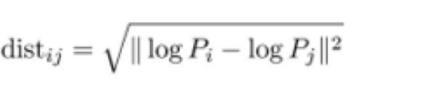
Potential Distance between distributions
Step 2: Distance between these probability distributions is a computed as an M-divergence
Cares about big and small probabilities
Step 3: Use metric MDS to represent these distances within 2-3 dimensions
C₁ = [ p₁₁ p₁₂ …….p_{1n}]
……
C_{i} = [ p_{i1} p_{i2} …….p_{in}]
…
C_{j} = [ p_{j1} p_{j2} …….p_{jn}]
…
C_{n} = [ p_{n1} p_{n2} …….p_{nn}]
probability distribution
P
1 2 3 … n

Slide 10
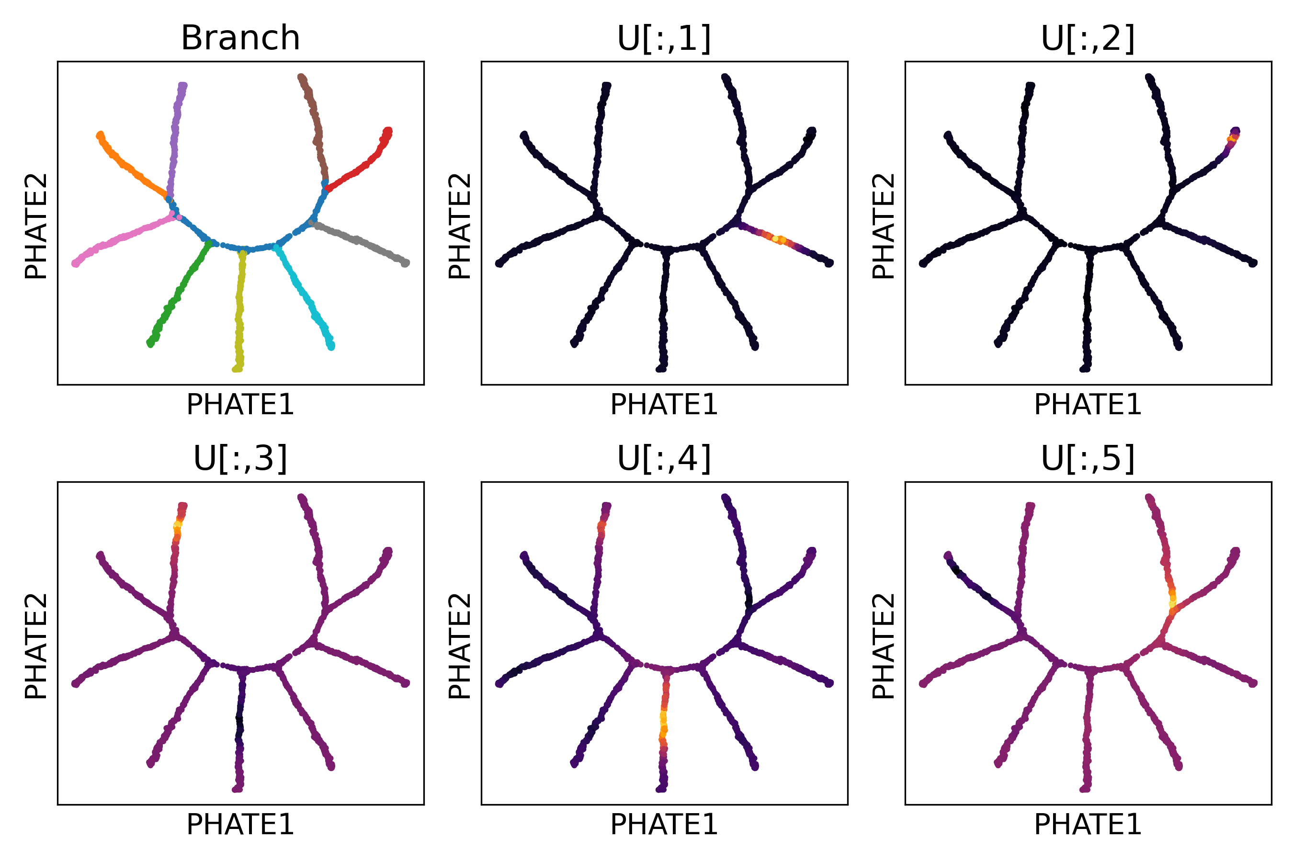
Diffusion components orthogonal, PHATE collects them in 2d

Slide 11
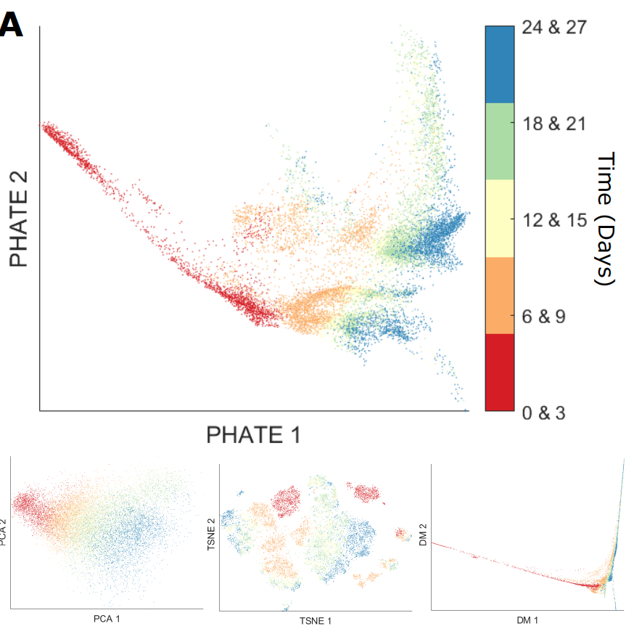
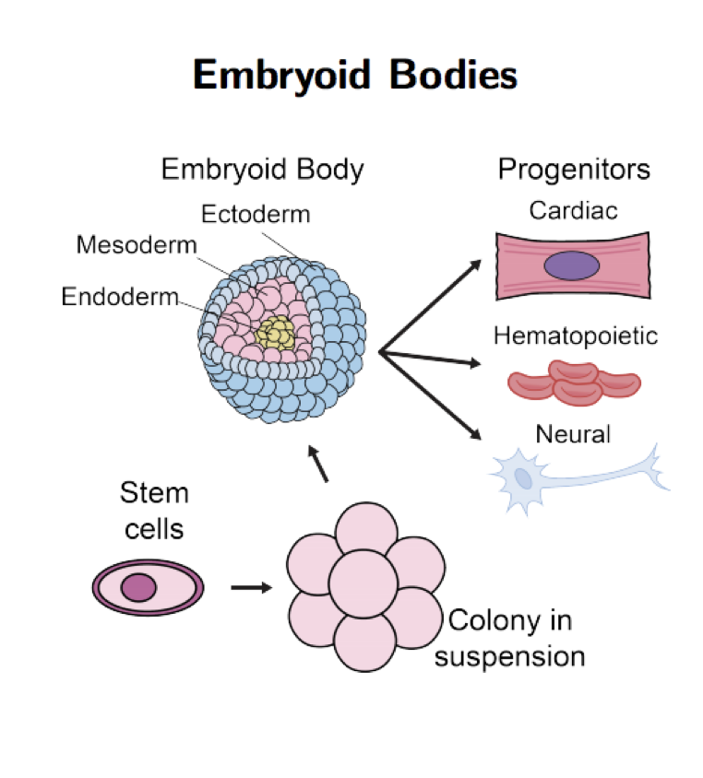
PHATE recovers structure in hESC development
27 day
time course
scRNA-seq
PCA
tSNE
Diffusion Maps

Slide 12
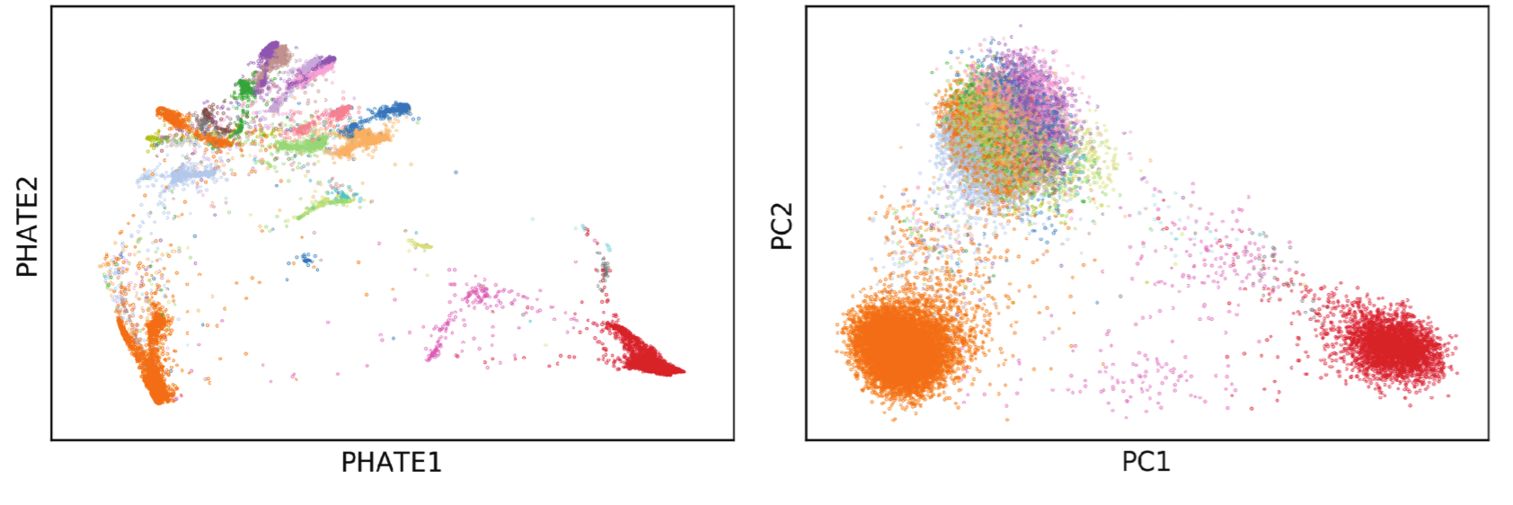
PHATE preserves local as well as global structure

Slide 13
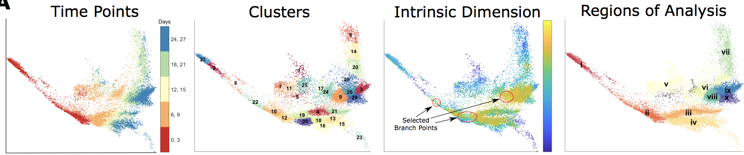

Slide 14
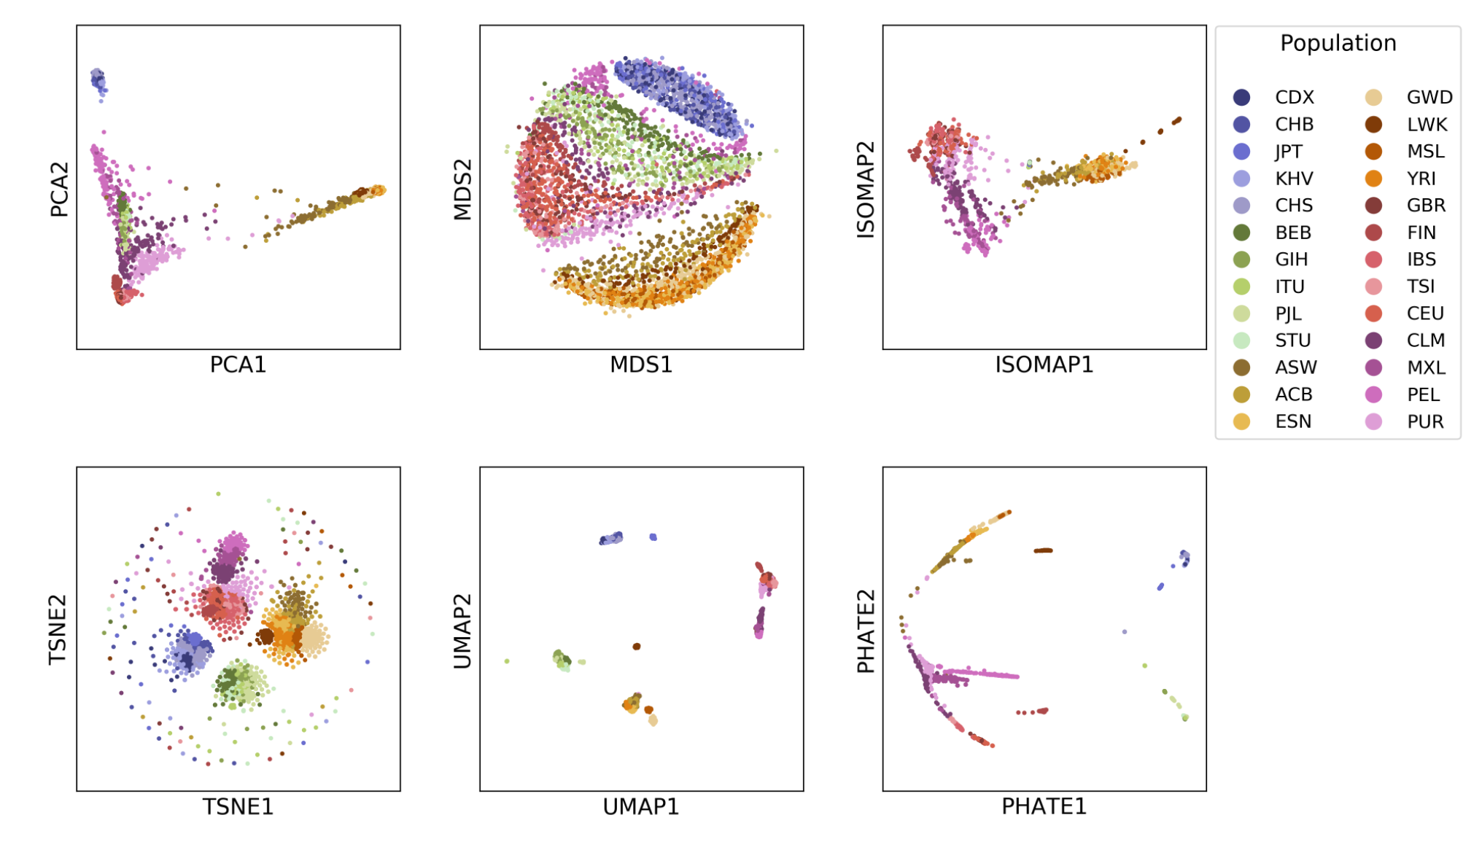
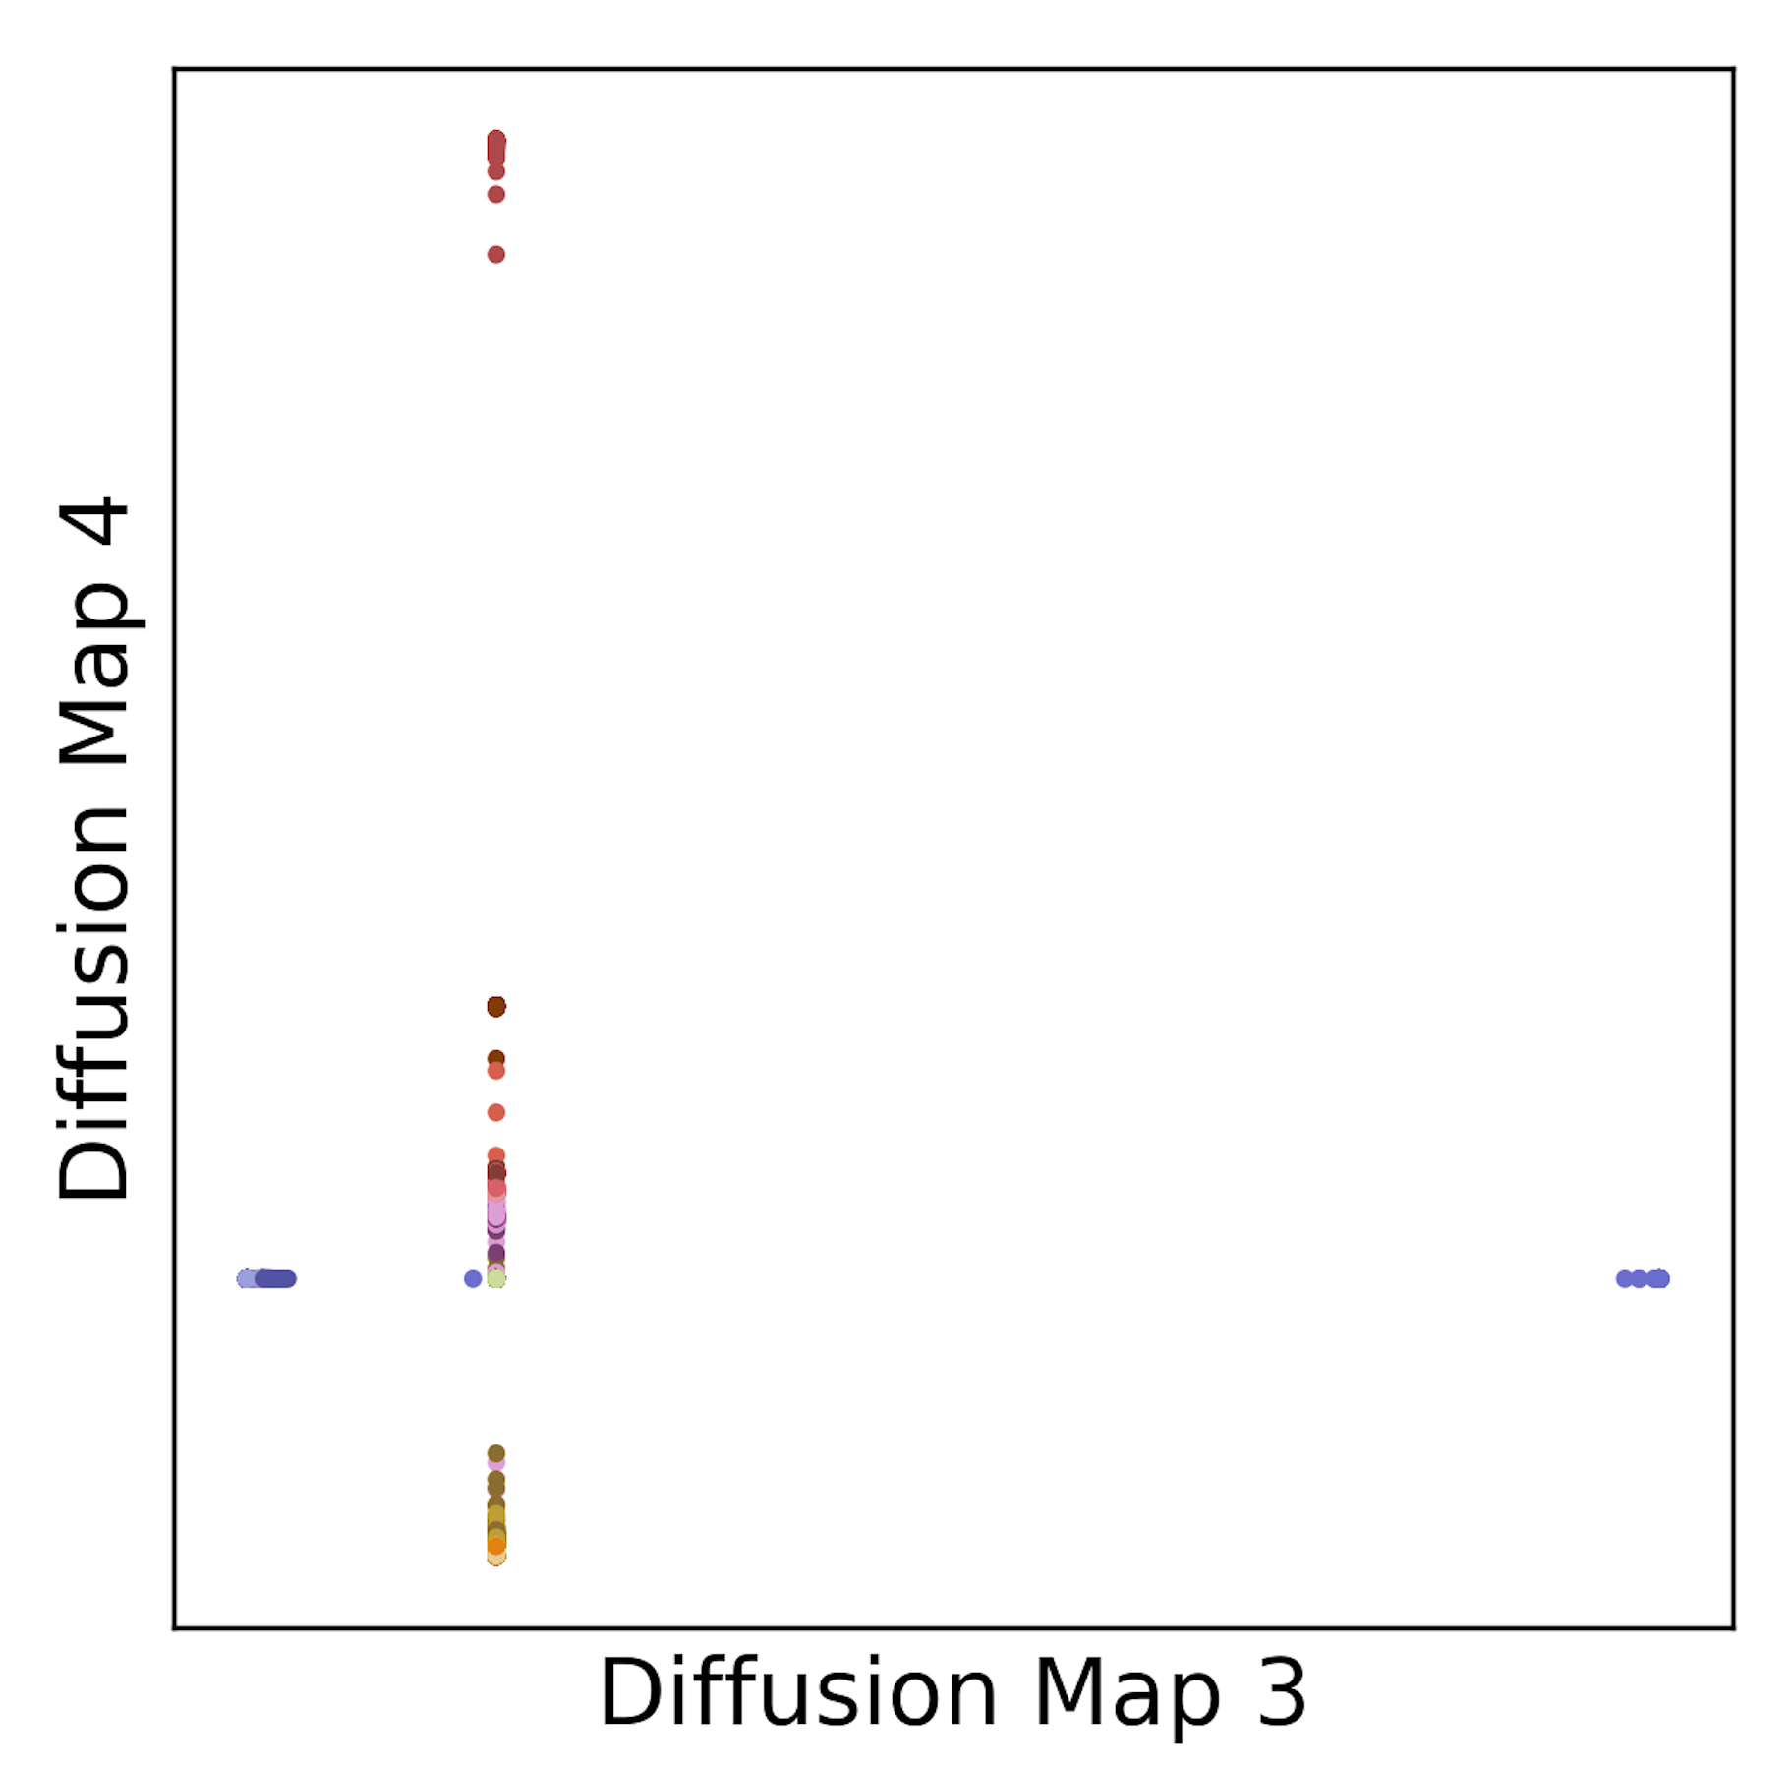
1000 Genomes

Slide 15
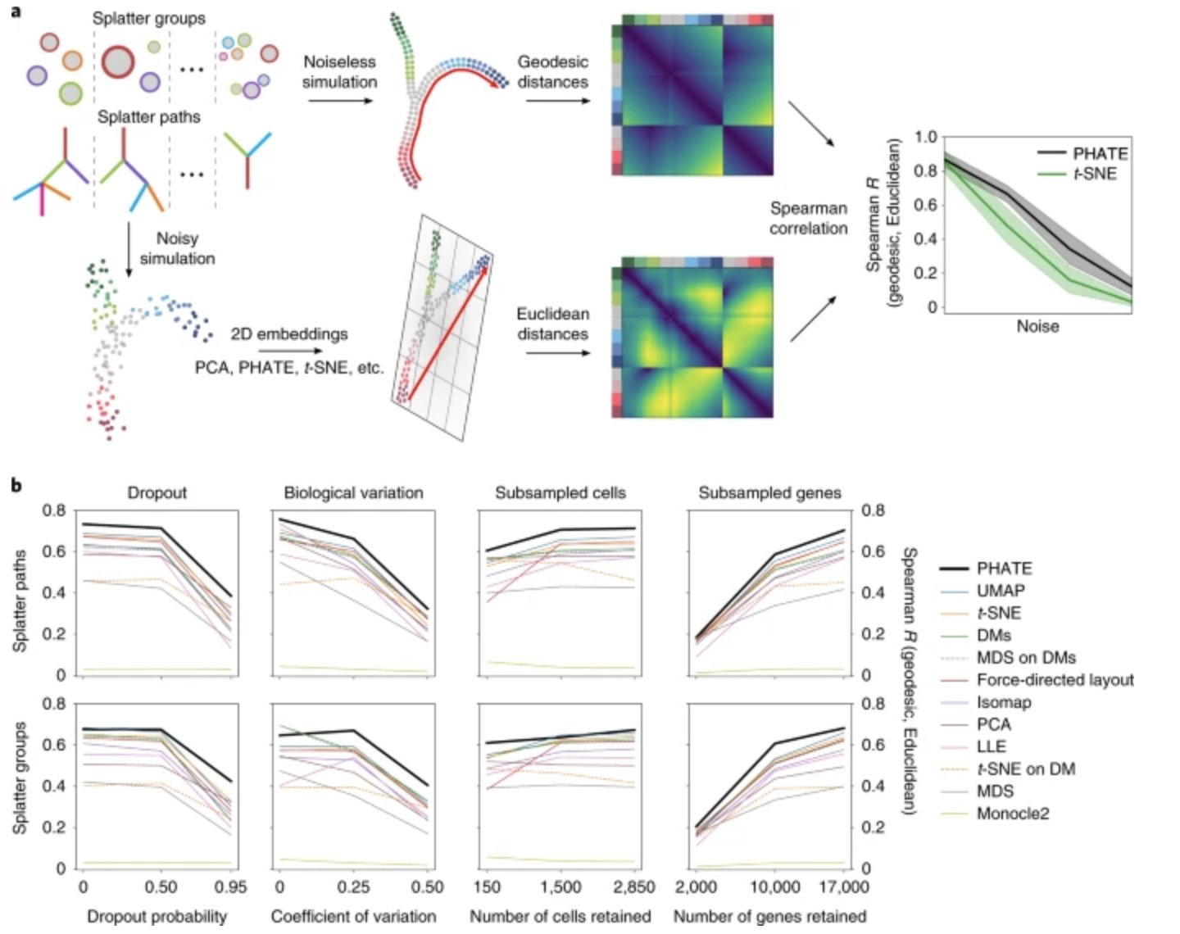
DeMAP

